Slide 1

When personalities collide: Examining the impact of consumer and brand personalities’ interplay on brand hate development
Abhishek Yadav (Doctoral Scholar)
Indian Institute of management, Kashipur, India
Dr. Somnath Chakrabarti, Ph.D.
Indian Institute of management, Kashipur, India
7th International Consumer Brand Relationships Conference

Slide 2
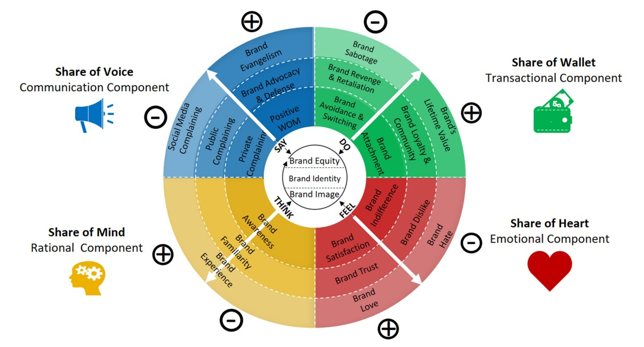
Introduction
Review of Literature
Hypotheses
Methodology
Results & Discussion
Brand Hate
Strongest negative emotion (Fetscherin & Raghabendra, 2021).
Relatively higher impact on consumer behavior (Ito et al., 1998; Rozin and Royzman, 2001)
Despite this, in comparison to research on positive emotions such as brand love (e.g., Albert and Merunka, 2013; Batra et al., 2012; Carroll and Ahuvia, 2006), brand attachment (e.g., Park et al., 2008; Thomson et al., 2005), and brand loyalty (e.g., Bloemer and Kasper, 1995; Chaudhuri and Holbrook, 2001), research on negative brand relationships such as brand avoidance (e.g., Lee et al., 2009; Rindell et al., 2013), anti-branding (e.g. Krishnamurthy and Kucuk, 2009; Kucuk, 2008), brand dislike (e.g. Dalli et al., 2006), and brand hate (e.g., Hegner et al., 2017; Zarantonello et al., 2016) is relatively scarce.
Source: Fetscherin, 2020

Slide 3
Introduction
Review of Literature
Hypotheses
Methodology
Results & Discussion
Brand hate
Brand hate literature has witnessed exponential growth in the past couple of years, with researchers exploring different brand hate stimuli and behavioral outcomes in diverse contexts (Yadav and Chakrabarti, 2022).
While extant brand hate literature encompasses multiple consumer level (e.g., Banerjee and Goel, 2020; Sarkar et al., 2021; Shuv-Ami et al., 2020), brand level (e.g., Bayarassou et al., 2020; Kähr et al., 2016; Zarantonello et al., 2018) and environmental (e.g., Bryson et al., 2021; Dessart and Cova, 2021; Wisker, 2020) antecedents of brand hate, the impact of brand’s personality on brand hate development has not been explored yet.
In addition, disorders in an individual’s personality can also lead to brand hate (Kucuk, 2016) thus, consumers’ feeling of hatred towards a brand varies with personality, and some may feel hatred more readily in comparison to others.
Kucuk (2018) has also proposed that certain personality types will develop brand hatred more easily than others.

Slide 4
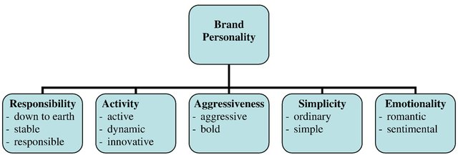
Introduction
Review of Literature
Hypotheses
Methodology
Results & Discussion
Brand personality
Brand personality has been studied for many years, in which Aaker’s (1997) seminal work is one of the first empirical research. She defines brand personality as “the set of human characteristics associated with a brand” and the brand’s ability to take on a personality or traits to relate to consumers as if they were a person (Azoulay and Kapferer 2003; Maehle et al. 2011).
However, all the five dimensions (Sincerity, Excitement, Competence, Sophistication, Ruggedness) may not have similar effect on brand related variables and will depend on specific dimensions (Eisend et al., 2013).
For example, numerous studies have focused only on the dimensions of sincerity and excitement out of these five dimensions y (e.g., Aaker et al., 2001; Hosany et al., 2006; Ivens & Valta, 2012; Sung et al., 2015).
These two dimensions capture much of the variance in brand personality ratings (Aaker, 1997) and has been validated as predictors of enhanced relationship (Aaker 2004; Roy et al., 2016).
Geuens et al. (2009) proposed a scale with higher affinity with Big Five model compared to Aaker’s scale (Alpatova and Dall’Olmo Riley, 2011)
We have considered two most relevant dimensions of responsibility and activity (Clemenz et al., 2012; Gordon et al., 2016; Sebastian et al., 2017) from the scale.

Slide 5
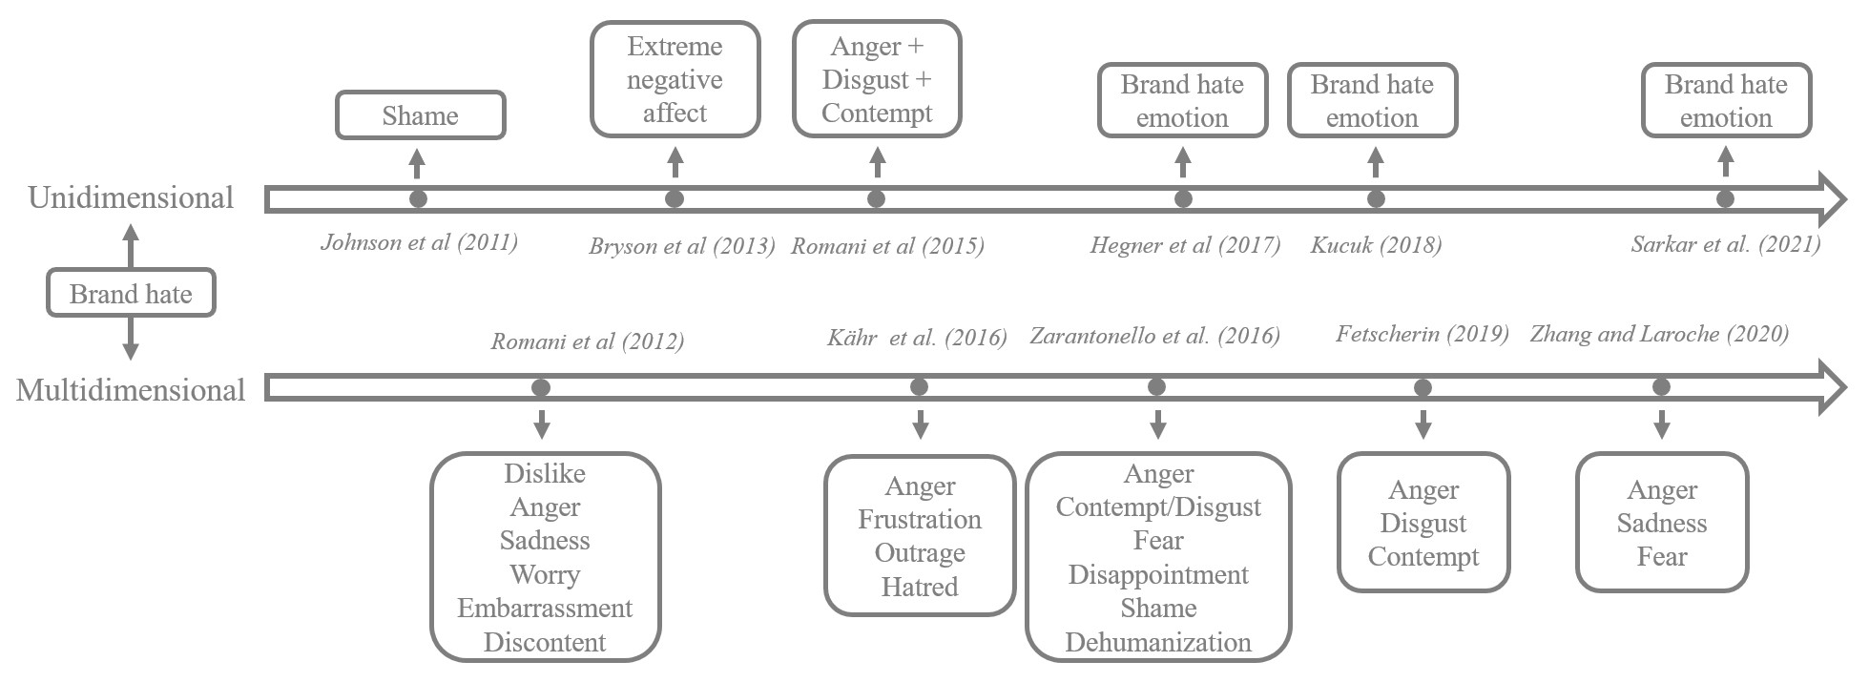
Introduction
Review of Literature
Hypotheses
Methodology
Results & Discussion
Brand hate
Brand hate is the strongest negative emotion towards a brand that a consumer can experience (Fetscherin & Raghabendra, 2021).
Researchers have explored both unidimensional (e.g., Hegner et al., 2017) as well as multidimensional (e.g., Kähr et al., 2016, Romani et al., 2015) nature of brand hate.
While the unidimensional conceptualizations define brand hate as a simple emotional construct or a relationship, the multidimensional conceptualizations consider brand hate as a complex emotion that is an amalgamation of other primary and secondary emotions.
For this study, we have utilized multidimensional conceptualization of brand hate.

Slide 6
Introduction
Review of Literature
Hypotheses
Methodology
Results & Discussion
Consumer’s personality
Big‐Five personality measures discuss an individual’s personality as having five major traits (Extraversion, Openness to New Experience, Agreeableness, Conscientiousness, and Neuroticism).
Big‐Five personality traits are differentially associated with positive emotions (Shiota, Keltner, & John, 2006), thus their relationships with naturally negative emotion such as hate can provide us with a comparative tool to understand the consumer personality and Brand Hate link.
Also, The more the consumers perceive congruence between themselves and the brand’s personality, the more likely they will develop a preference for the brand (Aaker, 1997).
This study examines the moderating effect of consumers’ personality traits on development of hatred in consumers.

Slide 7
Introduction
Review of Literature
Hypotheses
Methodology
Results & Discussion
Research objectives
To assess the impact of brand’s personality on brand hate development.
To assess the moderation effect of big five personality traits on brand personality-brand hate relationship.
To assess the impact of brand hate on anti-brand behavior.

Slide 8
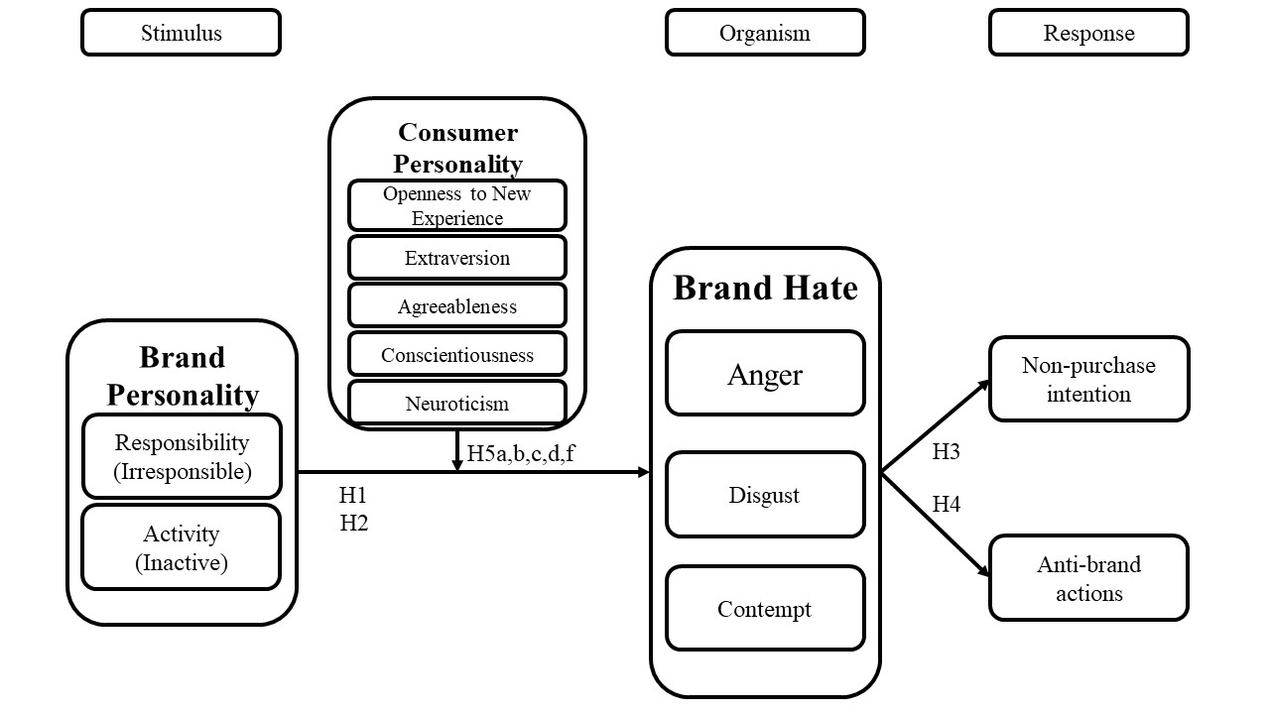
Introduction
Review of Literature
Hypotheses
Methodology
Results & Discussion

Slide 9
Introduction
Review of Literature
Hypotheses
Methodology
Results & Discussion
Measures, Sample and data collection & demographic characteristics
Sample:
  Brand haters
  Online and offline data collection
  Two markets
  370 valid responses
  Smart-PLS
    Disjoint two-stage approach
Questionnaire:
  Brand hate – Fetscherin (2019) (29 items)
  Brand personality – Geuens et al. (2009) (5 items)
  Consumer personality – Gosling et al. (2003) (10 items)
  Anti-brand actions – Romani et al. (2015) (6 items)
  Non-purchase intention – Ko et al. (2009) (3 items)
Factor | N | %
Gender
Male | 248 | 67
Female | 120 | 32.4
Other | 2 | 0.5
Age
16-25 | 154 | 41.6
26-35 | 119 | 32.2
36-45 | 60 | 16.2
46-55 | 20 | 5.4
56-65 | 11 | 3
>65 | 6 | 1.6
Hated brand category
Clothing/Footwear/Accessories | 133 | 35.9
Tech/electronics | 72 | 19.5
FMCG | 69 | 18.6
Other | 42 | 11.4
Service | 24 | 6.5
Automobiles | 18 | 4.8
Dining | 12 | 3.2

Slide 10
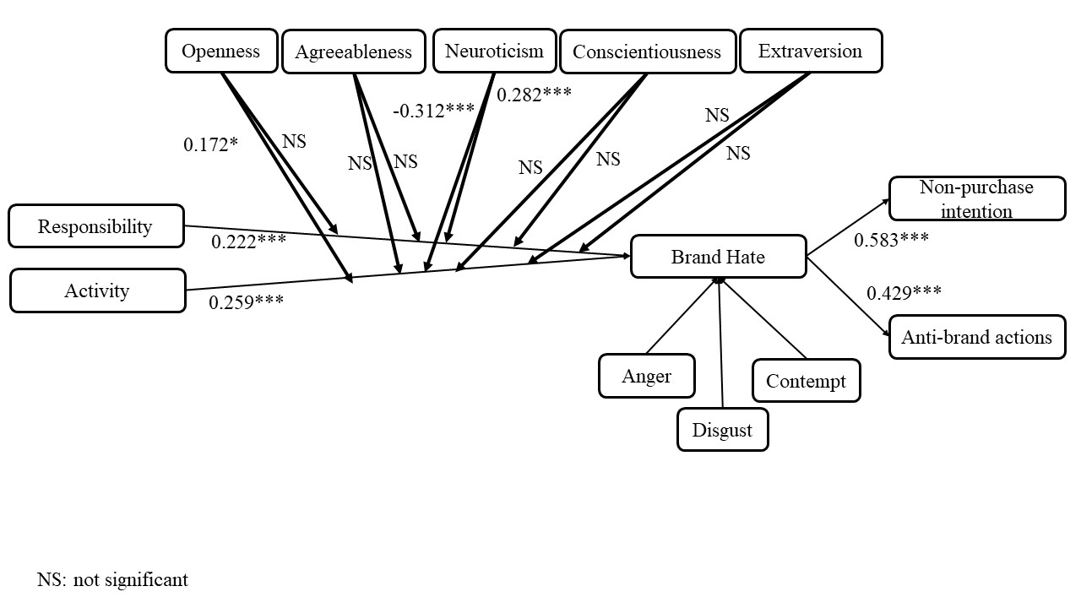
Introduction
Review of Literature
Hypotheses
Methodology
Results & Discussion
H1,H2, H3 and H4 are supported
Consumer high on neuroticism personality trait will experience more hatred towards and irresponsible brand.
However, hatred will be less if the brand is inactive or not innovative.
Consumers who are open to new experiences will experience more hatred if the brand is inactive.

Slide 11
Introduction
Review of Literature
Hypotheses
Methodology
Results & Discussion
Theoretical implications
Managerial implications
Limitations
Brand personality and brand hate relationship.
Significance of consumer personality and brand personality’s interaction.
Brand personality perception and negative consumer behaviour.
Brand’s focus on its consumers’ personality
Marketing communication highlighting non idle nature
10 item personality scale
Two markets
Brand personality dimensions
Other behavioural outcomes

Slide 12
Thank you

